Slide 1
CodePDE: An Inference Framework for LLM-driven PDE Solver Generation
Journal Club

Slide 2
Introduction
Partial differential equations (PDEs) are fundamental to modeling physical systems, yet solving them remains a complex challenge.
Traditional numerical solvers rely on expert knowledge to implement and are computationally expensive, while neural-network-based solvers require large training datasets and often lack interpretability.
Here it used a novel multi-agent LLM-driven PDE solver.

Slide 3
Introduction – Existing LLM PDE solver
CodePDE: multi-agent LLM-driven PDE solver
OpInf-LLM: data driven method (Operator Inference) combined with LLM.
MCP-SIM: A self-correcting multi-agent LLM framework for physics simulation.
PINNsAgent: Physics Neural Network combined with LLM.

Slide 4
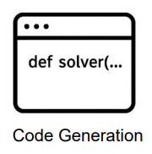

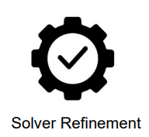






Methods – Multi-Agent
LLM only prompt: Given PDE… and Initial condition…, solve it… . Try to avoid bugs… Return the final solution as csv…
LLM with multi agent:
System prompt: You are an intelligent AI researcher for coding
PDE_description.py
Run it
Solver.py
nRMSE
PDE_solver.py
Solver_template.py

Slide 5
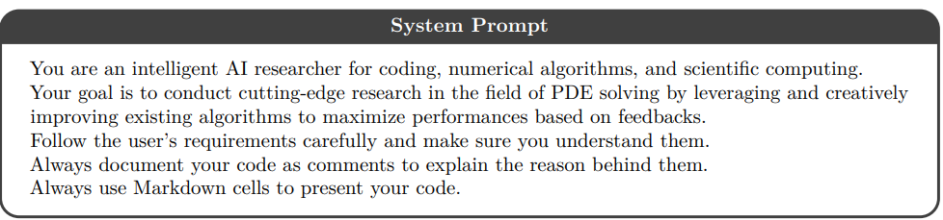
Methods – system prompt

Slide 6
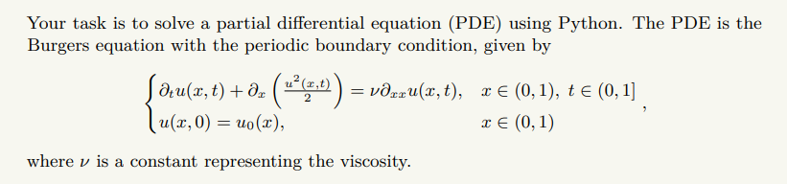
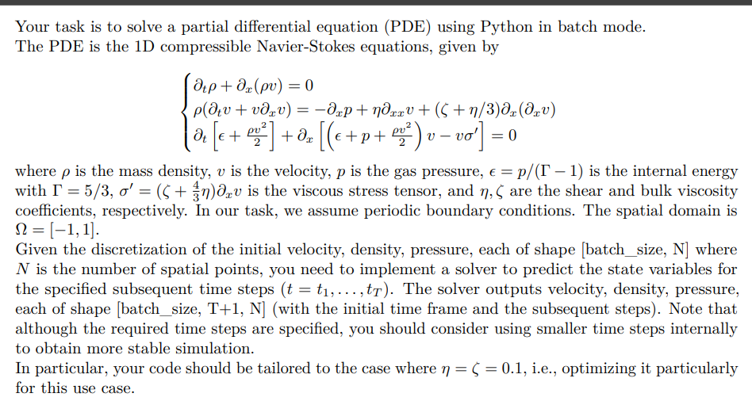
Methods – pde description prompt
In Latex

Slide 7
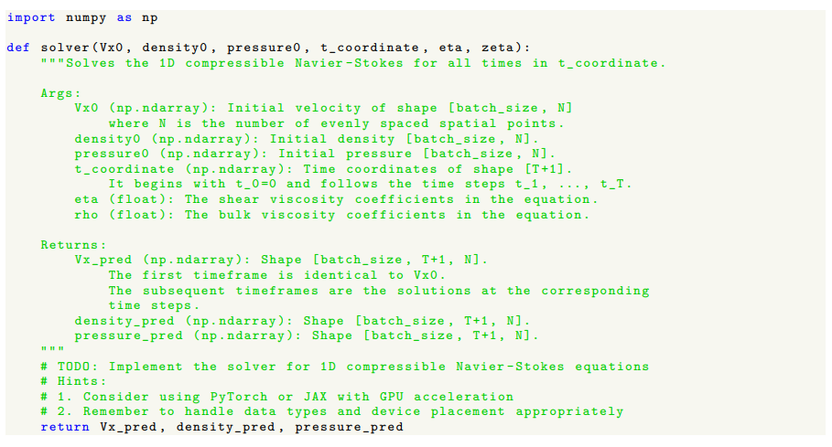
Methods – solver template prompt

Slide 8
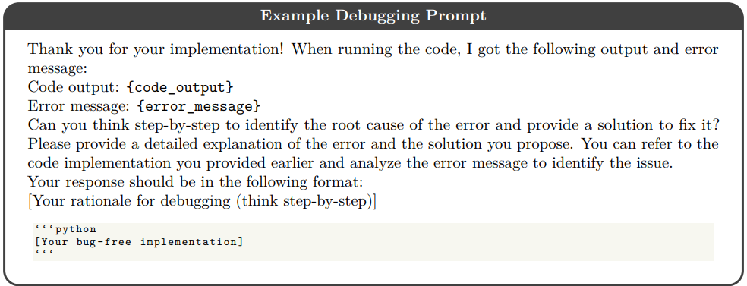
Methods – debug prompt

Slide 9
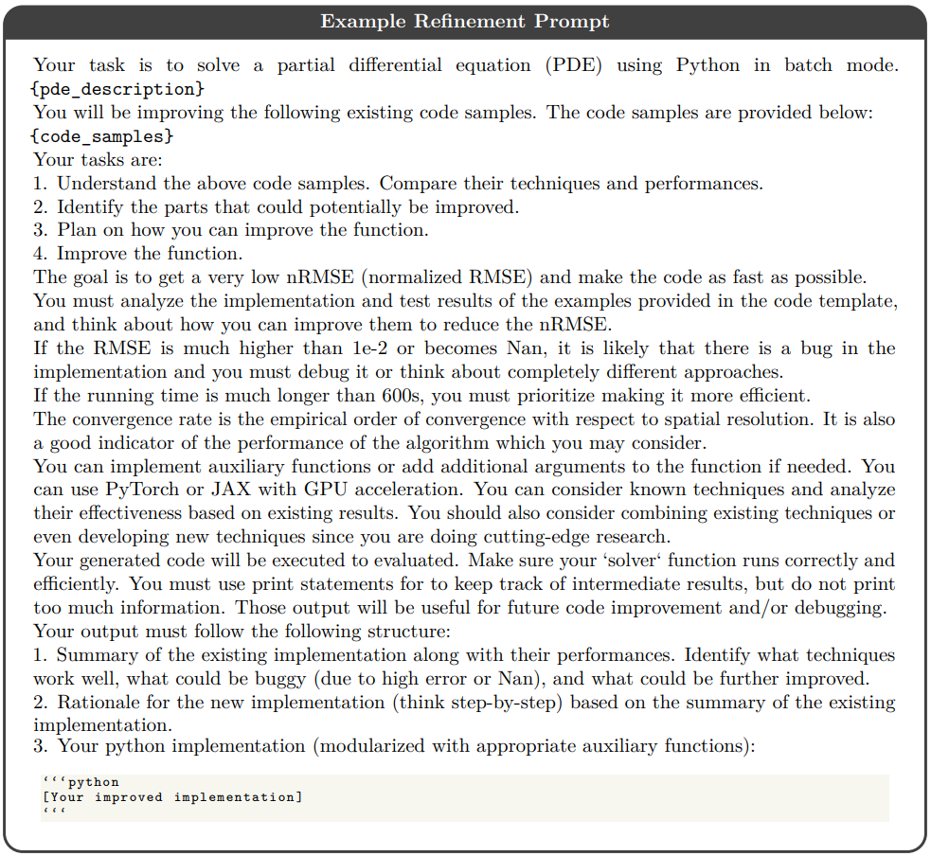
Methods – refinement prompt

Slide 10
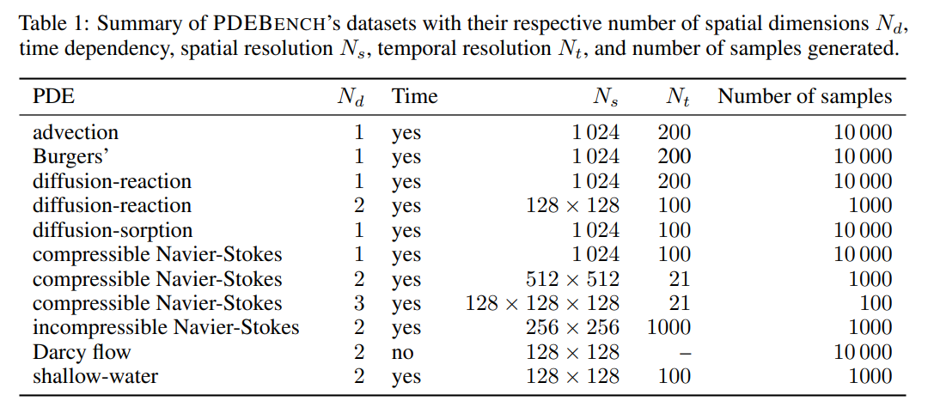
Evaluation data – PDEbench
A benchmark designed to evaluate how well machine learning models can solve or predict PDEs.

Slide 11
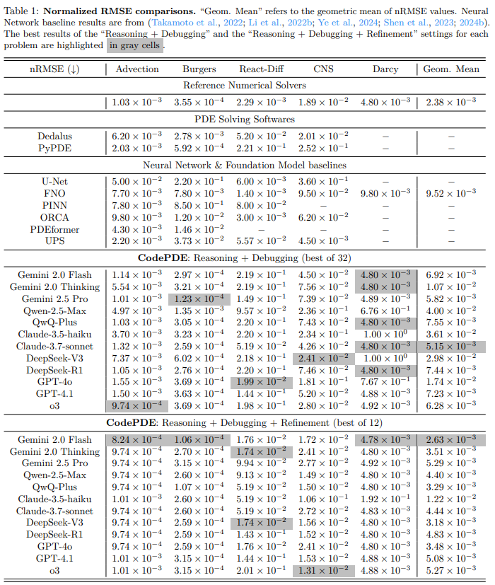
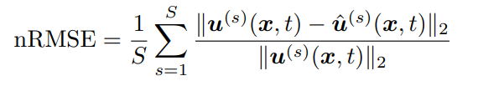
Result - nRMSE
S: number of PDE example

Slide 12
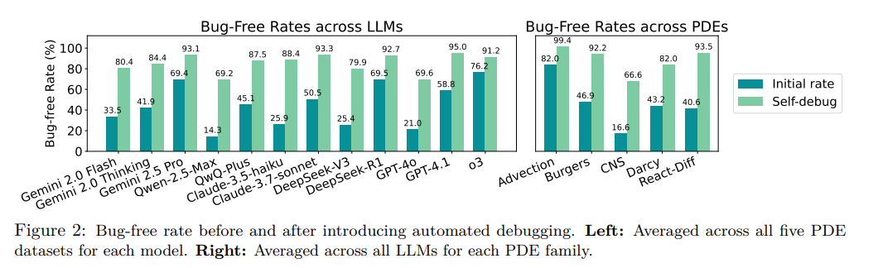
Result – bug-free rate
Bug-free rates tested across 32 independent trails of LLM coding.

Slide 13
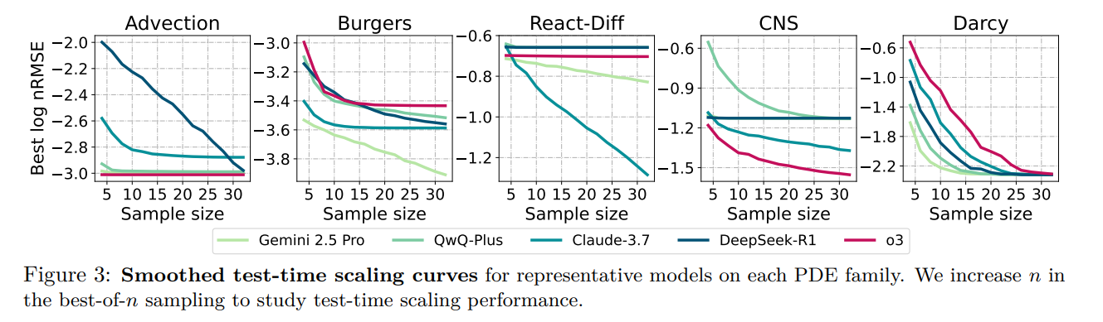
Result – test time scaling
Test time scaling tested across 32 independent trails of LLM coding.

Slide 14
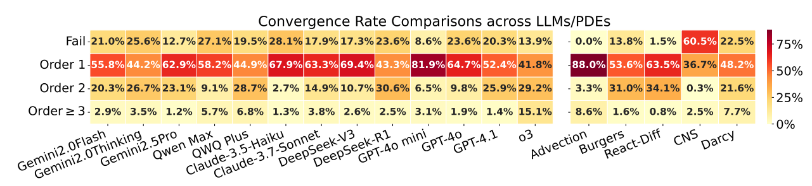
Result – Convergence rate
A solver is considered convergent if the nRMSE decreases as the grid is refined. The author defined four level: fail (no convergence or very slow convergence), order 1 2 3 (faster convergence)

Slide 15
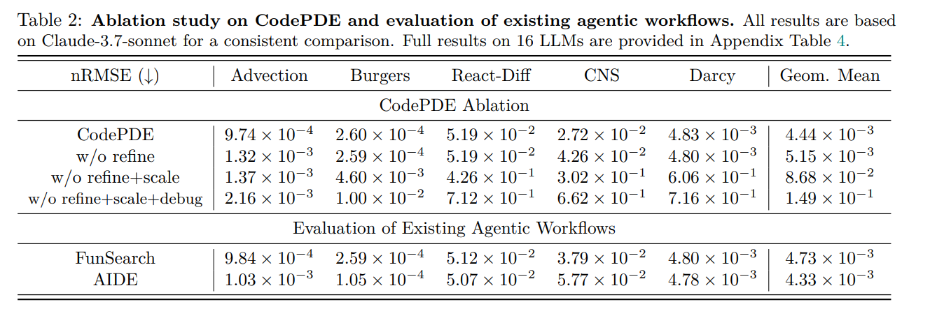
Result – Ablation test
Ablation test: testing performance if deleting some parts of the framework. (scale means multiple times trails of LLM coding)

Slide 16
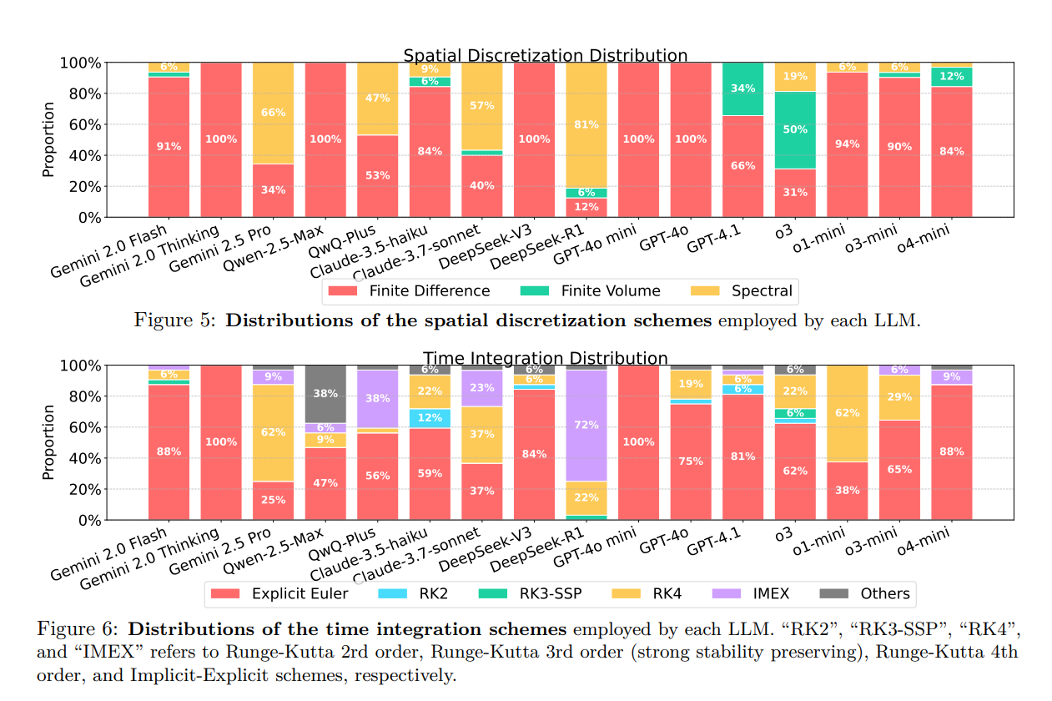
Result – Integration schemes employed

Slide 17
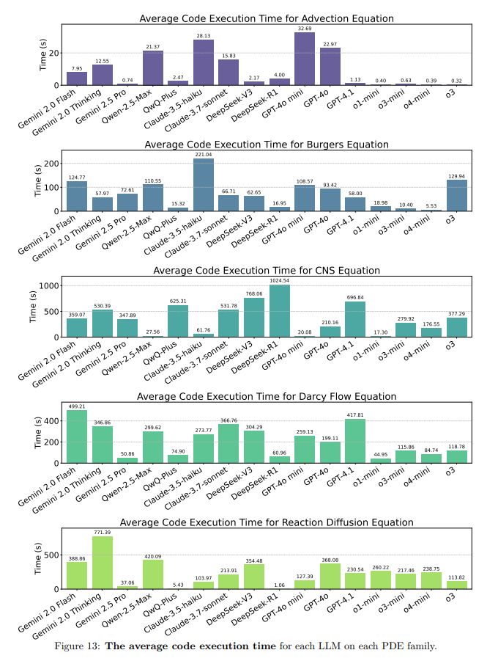
Result – Code Execution t
Running time of pde solver, not including the time to generate LLM responses.
Running time on 100 instances for a specific pde family

Slide 18
Conclusion
A structured inference framework with the combination of automated debugging, refinement, and test-time scaling is essential to solve PDEs with LLM.
Pure prompt engineering to generate reliable PDE solver is enough, without requiring any post or pre training of LLM.

